Slide 1

Inclusive Classroom
Culture Plan
Spencer Sherck

Slide 2
Purpose
The purpose of this Inclusive Classroom Culture Plan is to create a learning environment where every student feels valued, supported, and capable of success. I believe that students learn best when they feel safe, respected, and seen for who they are as individuals. Building an inclusive classroom isn’t just about meeting academic needs, it is about creating a community where diverse learners can thrive socially, emotionally, and behaviorally. This plan will guide my decisions as a teacher so that I can foster belonging, nurture student strengths, and ensure that all learners, regardless of background, ability, or experience have equitable opportunities to participate and succeed. Inclusivity is important to me because every student deserves a classroom where they feel they matter, where their voice is heard, and where they can grow into confident, resilient learners.

Slide 3
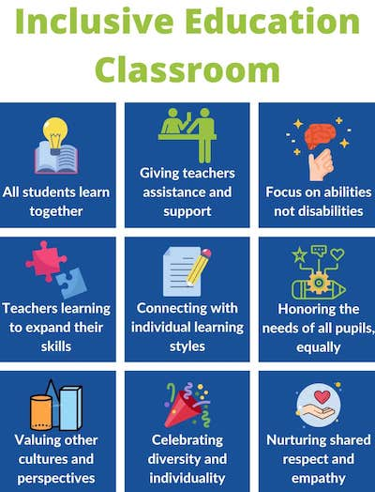

Slide 4
Letter Home
What to Expect in PE This Year:
A wide range of games, sports, and fitness activities
Opportunities to learn teamwork, respect, and responsibility
A safe and encouraging environment where all students can participate
Lessons that help students build lifelong healthy habits
What Students Will Need:
Comfortable clothing for movement
Closed-toe athletic shoes (important for safety)
A positive attitude and willingness to try their best
Dear Students and Families,
Welcome to a brand-new school year! My name is Spencer Sherck, and I am excited to be your child’s Physical Education (PE) teacher this year. I cannot wait to meet each of our students and begin building a classroom community centered around movement, teamwork, and fun!
In our PE class, students will explore a variety of activities designed to help them stay active, learn new skills, and develop confidence in their physical abilities. We will focus on cooperation, sportsmanship, problem-solving, and making healthy choices—skills that reach far beyond the gym. My goal is for every child to feel supported, challenged, and proud of their progress.
If your child has any medical needs, physical limitations, or concerns I should be aware of, please feel free to reach out. Working together ensures your child has the best experience possible in PE.
I am thrilled to begin this year with you and your child. Please don’t hesitate to contact me if you have any questions—communication is important, and I am always here to help.
Let’s have an amazing year full of movement, growth, and fun!
Warmly,
Spencer Sherck
Physical Education Teacher
UNE
SSherck@une.edu

Slide 5
Preparing For First Day
The first day of school in the gym is incredibly important because it sets the tone for the entire year. As a PE teacher, this is my chance to welcome students into a space where they will learn, move, play, and grow. Establishing a positive, energetic environment on that first day helps students feel safe, excited, and confident about participating.
It is also the day when I introduce routines, expectations, and procedures that help our class run smoothly. Teaching students how to enter the gym, where to sit, how to handle equipment, and how to communicate respectfully creates a foundation for success. When these systems are clear from day one, students know what to expect and feel more comfortable trying new skills and activities.
Most importantly, the first day is when I begin building relationships. Getting to know each student, learning their names, strengths, and interests and it helps me create lessons that are inclusive, supportive, and fun. When students feel seen and valued right away, they are more willing to take risks, work with others, and enjoy physical activity all year long.

Slide 6
Physical Education Class Setup Checklist
Gym Space & Safety
☐ Floors clean, dry, and free of hazards
☐ Walls and corners clear of obstacles
☐ Emergency exits accessible
☐ First aid kit stocked and visible
☐ Safety equipment (mats, cones, padding) in good condition
☐ Temperature and ventilation comfortable
Equipment Prep
☐ All equipment for the lesson set out and organized
☐ Backup equipment available (balls, pinnies, cones)
☐ Equipment checked for damage
☐ Storage areas neat and safely arranged
☐ Sanitizing wipes or spray available if needed

Slide 7
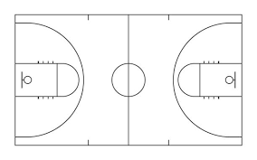
Office
Storage
Bean Bag Quiet Corner
Board
Door

Slide 8
First Day

Slide 9
Meeting Students At The Door
Meeting students at the door is important because it helps establish a positive classroom climate before the lesson even begins. Greeting students with a smile, eye contact, and their name builds trust, shows that you care, and helps every child feel seen and welcomed. It also allows you to quickly check in on their mood, energy level, or any concerns they may bring into class so you can better support them.
From a management standpoint, meeting students at the door sets the tone for expected behavior in the gym. It promotes a calm, organized transition and reduces confusion or unsafe behavior that might happen if students enter without guidance. This simple routine creates consistency, builds relationships, and helps start every class with structure and positivity.

Slide 10
Why That’s Important
Building strong relationships with students is crucial in PE because it creates a safe, supportive environment where students feel confident to participate, try new skills, and work with others. Positive relationships increase engagement, reduce behavior issues, and help students develop teamwork, respect, and social-emotional skills—all essential for both PE and life.
Greeting students by name as they enter the gym and checking in on how they feel.
Noticing individual strengths and effort during activities and offering specific praise.
Incorporating cooperative games or partner activities so students interact and support each other.
Listening and responding to student ideas or concerns, even briefly during transitions.
Modeling respect, encouragement, and patience in your own behavior.

Slide 11
https://www.ted.com/talks/rita_pierson_every_kid_needs_a_champion

Slide 12
Routines And SOP’s
Entering the Gym
Behavioral SOP: Walk in quietly, go to your spot or line, wait for teacher signal.
Academic SOP: Have materials ready if needed (Clipboard, water bottle). Teacher greets each student by name.
Listening Signal
Behavioral SOP: Stop moving when the teacher gives the listening signal (whistle, clap, hand up). Eyes on the teacher, quiet, ready to participate.
Academic SOP: Pay attention to instructions for skill practice, games, or rules before starting an activity
Using Equipment
Behavioral SOP: Only touch equipment when instructed. Use safely, return to proper place.
Academic SOP: Learn and practice proper techniques for all equipment. Participate in drills or stations as instructed.
Ending Class
Behavioral SOP: Return equipment neatly, clean up space, go to line or spot.
Academic SOP: Reflect briefly on skills learned, self-assess effort, or set a goal for next class.
Water & Bathroom Breaks
Behavioral SOP: Raise hand or wait for a break. Go quickly, return quietly.
Academic SOP: Plan ahead; return promptly to continue participation.

Slide 13


Slide 14
Create Shared Vision
Creating a shared vision for our PE class is important because it helps students feel ownership of the rules and understand why they matter. We begin by asking what kind of PE class we want. A safe, fun, respectful, and active environment. Then work together to turn those ideas into simple expectations everyone can follow. Together, we create rules like be safe, be respectful, be responsible, and try your best, all based on the values the students identify. This shared vision helps us start the year as a team and ensures that every student feels included and ready to learn and have fun in PE.

Slide 15
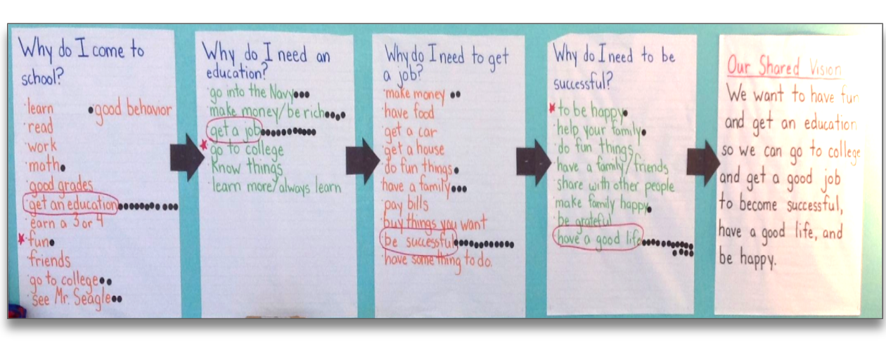

Slide 16
Affinity Process: Shared Vision & Code of Cooperation
Steps We Took:
Brainstorming Ideas
Grouping Similar Ideas (Affinity Step)
Labeling Core Values
Creating the Shared Vision Statement
Developing the Code of Cooperation
Outcome:
By following the affinity process, students helped shape both the Shared Vision and Code of Cooperation, ensuring the classroom culture reflects their values and promotes safety, respect, effort, and fun in PE.

Slide 17
SEL Add-On
SEL Movement Activity (Self-Management & Social Awareness)
Emotion Walk: Move around the gym showing how you feel today (fast, slow, jump, balance).
Partner Mirror: Students pair up and mirror each other’s movements, building empathy and focus.
Team Challenge: Small cooperative activity, like passing a ball without dropping it, fostering teamwork and communication.
Reflection & Goal-Setting (Responsible Decision-Making & Self-Management
Quick discussion: “How did I work with others today?” or “What is one thing I will try my best at in PE today?”
Optional: Students give a thumbs-up/thumbs-down or use emoji cards to show readiness.

Slide 18
School Tour
During our school tour, I will show the important places you may need during PE. You will see the gym, where we will have all our activities, and the equipment storage, so you know where everything belongs. I will also show you the bathrooms and explain how to use them responsibly during class, the nurse’s office, so you know where to go if you feel sick or get hurt, and the water fountains, so you can stay hydrated while being active. Knowing these locations helps everyone stay safe, healthy, and ready to participate in PE every day.

Slide 19
Reactive vs. Proactive Teachers
Reactive Teacher
A reactive teacher responds to problems after they happen.
For example:
Students are running unsafely, and the teacher yells at them after someone almost gets hurt.
Equipment is left out, and the teacher reprimands students during class instead of setting clear routines.
Downside: This can lead to confusion, inconsistent expectations, disruptions, and unsafe situations because students don’t know what is expected beforehand.
Proactive Teacher
A proactive teacher anticipates issues and prevents them before they occur.
For example:
Establishes clear entry, exit, and equipment routines on the first day.
Sets rules for safe movement and personal space, reviews them regularly, and models expectations.
Monitors student behavior and redirects before problems escalate.
Upside: This creates a safe, structured, and positive learning environment where students understand expectations, behavior problems are minimized, and more time is spent on learning and activity.

Slide 20
Teacher Language
Teacher language is one of the most powerful tools we have in PE. The words we use can shape student behavior, motivation, and learning. In the gym, where students are moving and using equipment, being intentional with language helps maintain safety, focus, and engagement.
Reinforcing
Purpose: To acknowledge and encourage positive behavior or effort.
When to Use:
When a student follows directions or demonstrates effort: “Great job keeping your space!”
During skill practice: “I love how you tried your best on that jump!”
After teamwork: “I noticed how you encouraged your partner—excellent teamwork!”
Effect: Strengthens desired behaviors, boosts confidence, and motivates students to continue positive actions.
Redirecting
Purpose: To correct inappropriate or unsafe behavior quickly and calmly.
When to Use:
If a student is off-task, unsafe, or disruptive: “Please return to your spot and use your equipment safely.”
During group activities: “Stop throwing the ball until everyone is ready.”
When personal space is violated: “Remember, keep your bubble space so everyone is safe.”
Effect: Minimizes risk, restores focus, and maintains a positive learning environment.
Reminding
Purpose: To prompt students to remember expectations before a problem occurs.
When to Use:
At the start of class: “Remember, keep your hands and feet to yourself.”
Before transitions: “When you hear the whistle, freeze and look at me.”
During activities to reinforce routines: “Stay in your personal space while dribbling the ball.”
Effect: Prevents problems before they happen and reinforces consistency.

Slide 21
Sensory Safe Classroom
Creating a sensory-safe environment in gym class is essential because many students can become overwhelmed by loud noises, fast movement, or unpredictable transitions. As a PE teacher, you can support all learners by providing consistent routines, offering quiet corners or calming stations, and using visual schedules to show what activities are coming next. Giving students options such as noise-reducing headphones, softer equipment, or modified participation helps them feel comfortable and secure. By being aware of sensory triggers, lowering unnecessary volume, and giving clear, calm directions, you create a gym space where every student feels safe, regulated, and ready to learn and move.

Slide 22
Casel 5 Competencies
In gym class, the CASEL 5 Competencies, self-awareness, self-management, social awareness, relationship skills, and responsible decision-making become the foundation for meaningful connection and a positive class climate. Short check-ins or movement-based greetings build self- and social-awareness as students recognize their emotions and acknowledge others. Quick mindfulness stretches or breathing exercises strengthen self-management before active lessons begin. Partner discussions or team-building warm-ups help students practice relationship skills, like communication and cooperation. Finally, reviewing daily goals or reflecting on choices encourages responsible decision-making that carries into gameplay. By weaving these competencies into simple routines, PE teachers set the tone for safe, supportive, and inclusive movement experiences.

Slide 23
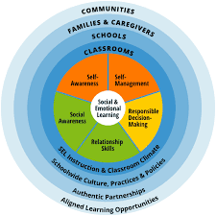

Slide 24
Non-Negotiables and Consequences
In PE, non-negotiables are the essential behaviors that keep everyone safe and allow class to run smoothly. These include listening when the teacher is talking, keeping hands and equipment to yourself, using safe movement at all times, and showing respect to classmates and adults. When a non-negotiable is broken, consequences should be predictable, calm, and consistent. A typical progression might include:
Reminder of the expectation.
Redirect with a quick reteach or change in behavior.
Reflection break (brief time-out to reset).
Loss of privilege (sit out of a small part of an activity).
Parent/teacher communication if unsafe or repeated behaviors continue.

Slide 25
Non-Negotiables for PE
Listen and stop immediately when you hear the whistle or teacher’s voice.
Use safe movement at all times (no running into others, no rough play).
Keep hands, feet, and equipment to yourself unless instructed.
Respect all classmates and adults, kind words and actions only.
Use equipment correctly and safely (no throwing without permission, no swinging items).
Stay in the activity area/do not leave the gym without permission.
Try your best and participate in whatever form you are able.
Wear safe shoes and keep them tied.
Be responsible for your body and your space (Be aware of others).

Slide 26
Classroom Discipline Plan: Punitive vs. Restorative
Punitive
A punitive discipline plan uses clear consequences when rules are broken. In PE, this might mean sitting out, losing equipment privileges, or calling home after repeated unsafe behavior. It stops misbehavior quickly and keeps the class safe, but it doesn’t always teach students how to make better choices.
Restorative
A restorative discipline plan focuses on repairing harm and teaching responsibility. In PE, this could include a quick reflection talk, apologizing to a peer, or practicing the correct behavior before rejoining the activity. It helps students understand the impact of their actions and learn healthier ways to handle problems.

Slide 27
Executive Skills in the Inclusive Classroom
Executive skills are the mental abilities students use to manage their behavior, emotions, and learning. These include skills like planning, staying organized, focusing, controlling impulses, working with others, and managing frustration. In an inclusive classroom it’s important to support students at different levels of development. Teachers can break tasks into clear steps, model routines, provide visual cues, and offer choices to help students stay regulated and successful. By intentionally building executive skills through structured routines, predictable expectations, and supportive feedback, all students and those especially who struggle with attention, behavior, or transitions, can participate fully and confidently in class activities.

Slide 28
Behavior Catalog

Slide 29
Teaching Philosophy
As a physical education teacher, my philosophy is to create a safe, inclusive, and joyful environment where every child feels confident moving their body and trying new things. I believe PE should build lifelong skills—teamwork, resilience, responsibility, and self-awareness—while helping students discover the fun in physical activity. Through clear routines, supportive relationships, and meaningful skill development, I aim to meet all learners where they are and help them grow physically, socially, and emotionally.

Slide 30
Mission Statement
My mission is to inspire every student to be an active, respectful, and responsible participant in our PE community. I strive to provide engaging activities, teach fundamental movement skills, and nurture a positive mindset toward health and fitness. I am committed to ensuring that all students feel valued, safe, and motivated so they can build confidence, develop healthy habits, and enjoy movement both inside and outside of school.

Slide 31
Spencer Sherck’s Inclusive Classroom
As a PE teacher, my goal is to create a safe, inclusive, and structured environment where every student feels confident, engaged, and valued. From the first day, I establish routines, greet students at the door, and guide them through a tour of key areas including the gym, equipment storage, bathrooms, nurse’s office, and water fountains to ensure safety and clarity. I build a shared vision and Code of Cooperation with students, emphasizing non-negotiables like safe movement, respect, responsibility, and effort, and use clear procedures and teacher language reminding, reinforcing, and redirecting to maintain expectations. My approach balances proactive management with restorative practices, teaching students to repair harm and reflect on choices while providing immediate consequences for unsafe behavior. I integrate social-emotional learning, executive skills, and sensory supports through movement, check-ins, cooperative games, and reflection, helping students develop self-awareness, self-management, relationship skills, social awareness, and responsible decision-making. Overall, my mission is to inspire lifelong physical activity, teamwork, and personal growth, ensuring that every student participates fully, feels included, and experiences the joy and benefits of movement.

